Slide 1
Navigating Success for Cyclistic Bike-Share
Muhammad Satrio Pamungkas Suharoyo

Slide 2
Table of Content
Company Background, Goals, list of provided data and list of work
Comparing bicycle usage among member types, across different days, among different bicycle types, and Analyzing bicycle usage in Q1 2023
Conclusion and Recommendation

Slide 3
Cyclistic Bike-Share Background
In 2016, Cyclistic launched a successful bike-share offering
The program has grown to a fleet of 5,824 bicycles that are geotracked and locked into a network of 692 stations across Chicago
The bikes can be unlocked from one station and returned to any other station in the system anytime
In cylistic there are a few plans for the customers: single-ride passes, full-day passes, and annual memberships. Customer who purchase single-ride and full-day pass referred as Casual riders, Customer who purchase annual memberships are Cyclistic members

Slide 4
Goals
Determining which member type should be the main focus
Identifying the usage trends for Q1 2023
Deciding if more bicycles are needed and at which stations

Slide 5
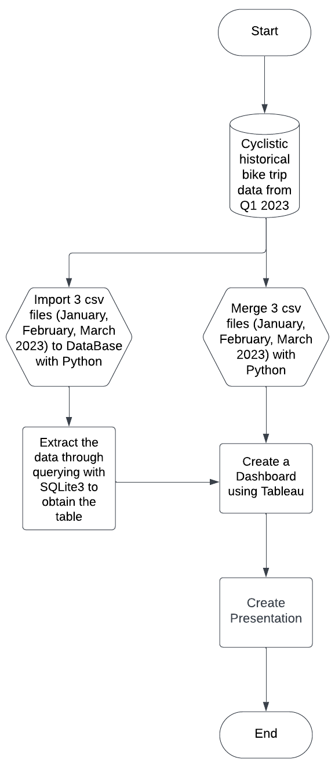
List of work
List of provided data
Cyclistic historical bike trip data from January 2023
Cyclistic historical bike trip data from February 2023
Cyclistic historical bike trip data from March 2023

Slide 6
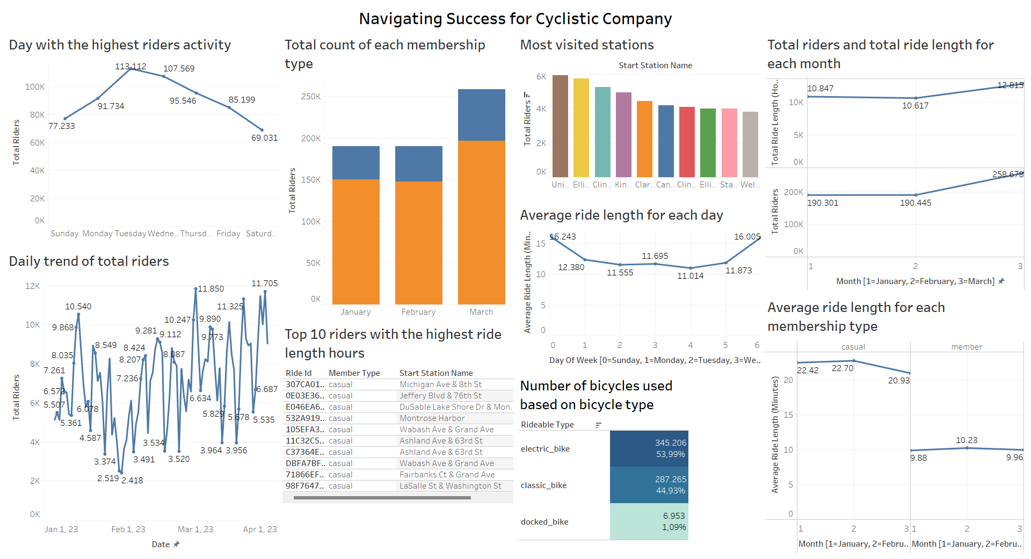

Slide 7
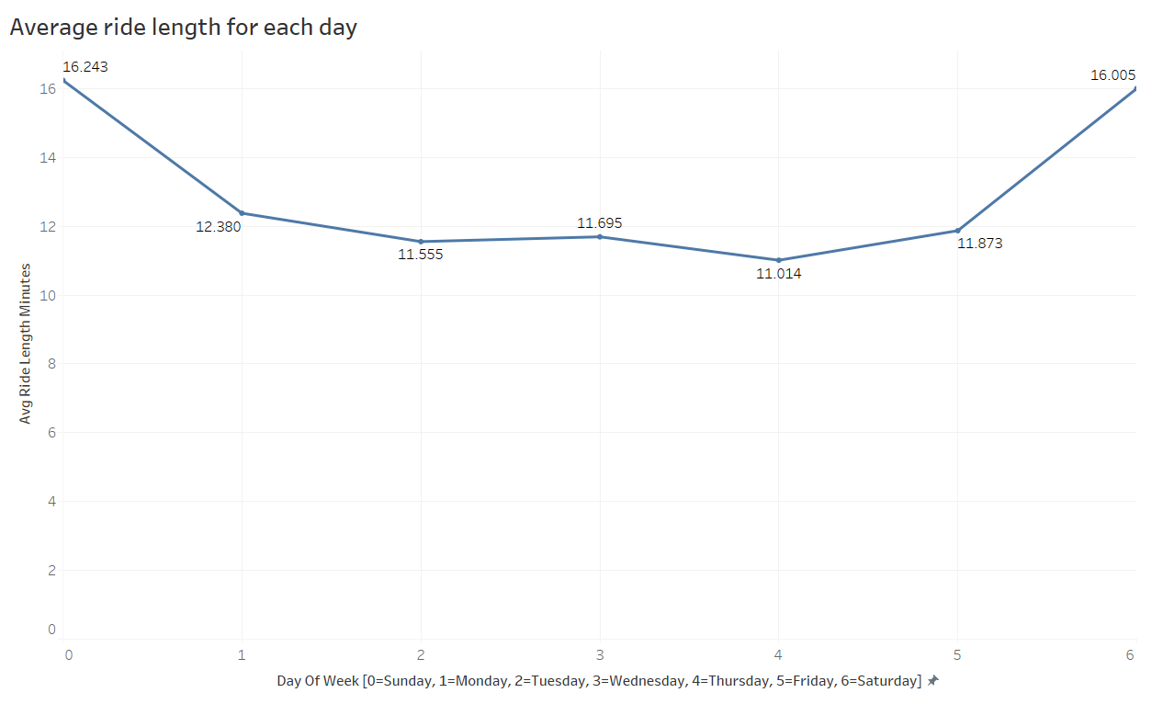
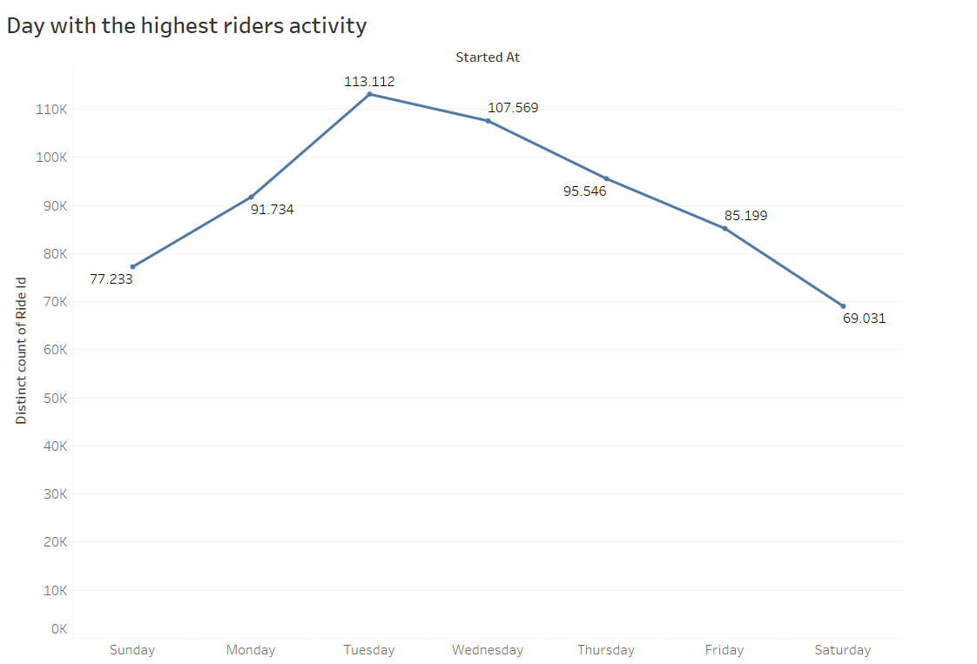
Daily Trend in average ride length and total riders
The behavior of bicycle users on weekdays typically involves a larger number of users, resulting in a higher total number of bicycle users during weekdays. However, the total usage time is relatively shorter
In contrast to bicycle users on the weekend, the total number of bicycle users is fewer, but the total usage time is longer
The assumption is that bicycles are primarily used for commuting to work and school, which is why there are more bicycle users on Tuesdays and Wednesdays
On weekends, bicycles are used for recreation. Even though the total number of users is smaller, the total usage time is relatively longer

Slide 8
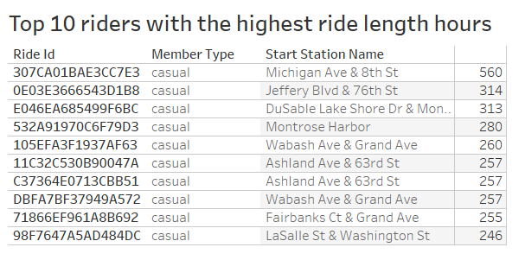
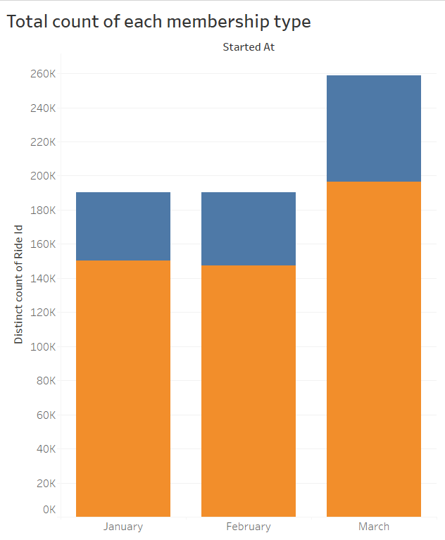

Total riders of each member type
The top 10 bicycle users are casual member
Among the Cyclistic bicycle users, 75% are cylistic member
From the two points above, by focusing on individuals who do not have a subscription but have significant usage, the company can maximize its profits and maintain loyal customers

Slide 9
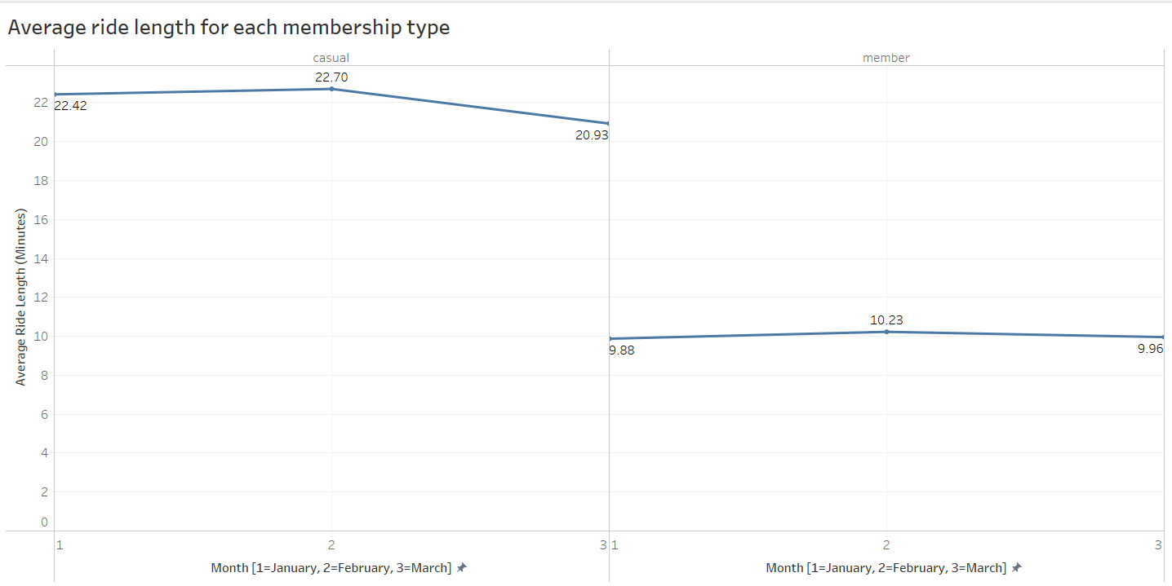
Ride length of each member type
Casual members tend to have longer ride length
It can be concluded that the behavior of Casual members is that they only use the service occasionally, but when they do, the ride length is quite long
It can also be assumed from this that the distance covered by Casual members is greater than that of Cyclistic members

Slide 10
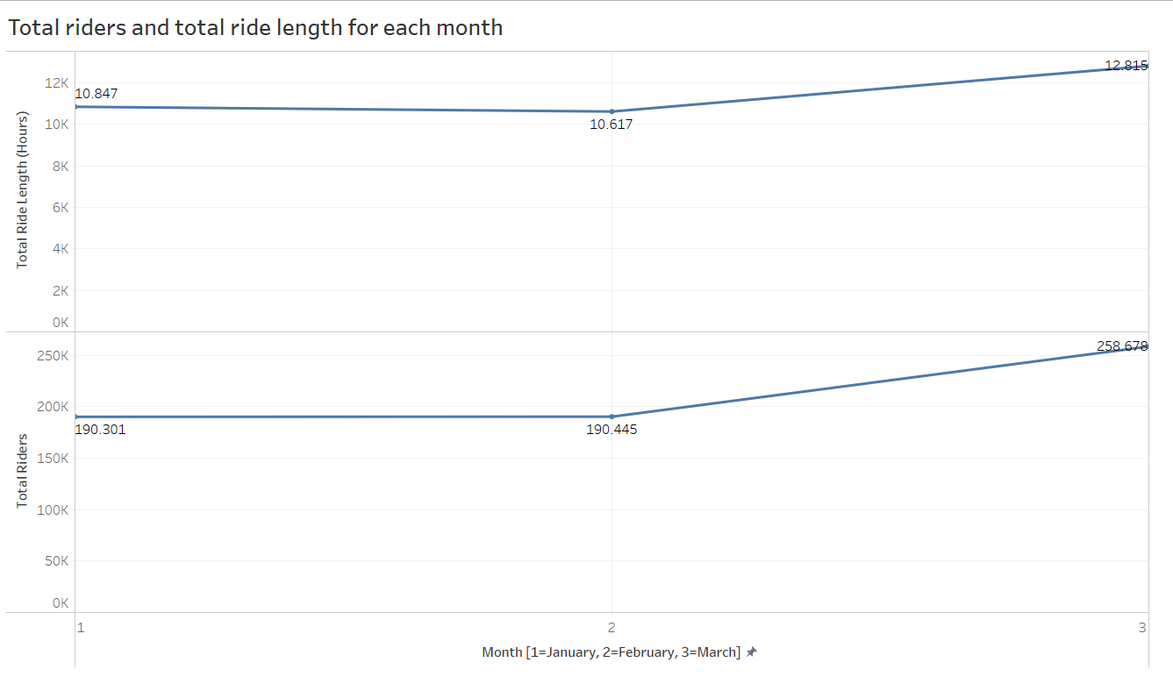
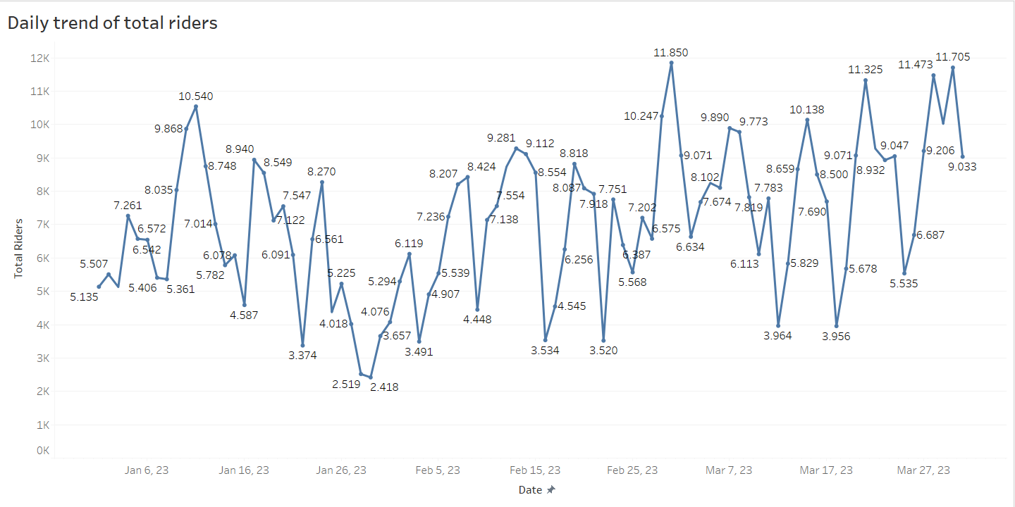


Daily trend and monthly trend of total riders
The total number of bicycle users and the total usage time of bicycles significantly increased in March 2023. This is because, in March, the winter season is almost ending, leading to an increase in bicycle usage
The needs for the spring and summer seasons, it is necessary to add more bicycles. Currently, there are a total of 5,800 bicycles, but the total riders in Q1 per day briefly reached 11,000

Slide 11
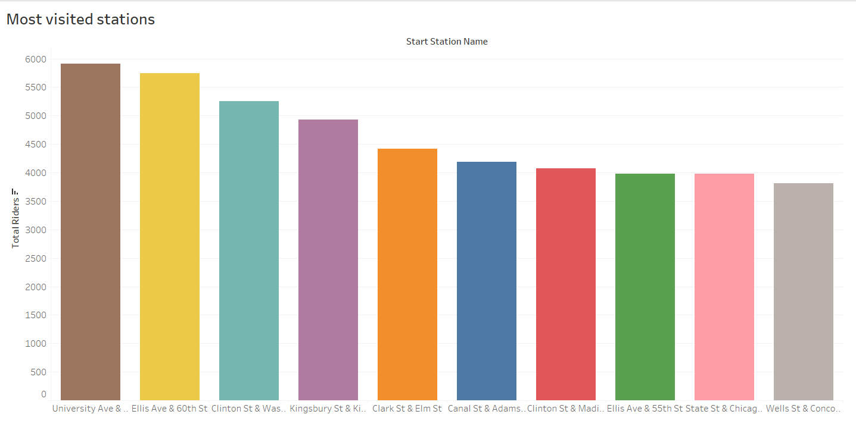
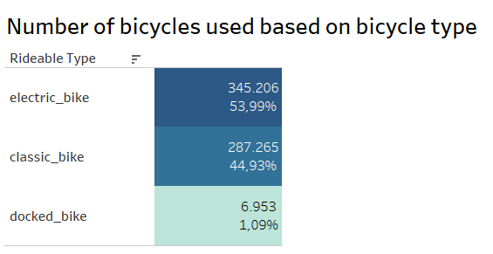
Most visited station and most used bikes based on bicyle type
Classic bike and electric bike are highly popular
Bicycle stations at University Ave & 57th, Ellis Ave & 60th, Clinton St & Washington Blvd are the most frequently visited stations
To increase number of bicycle units, it's advisable to add both electric and classic bicycles since both types of bicycles are in high demand. Or, to attract customer attention, also consider adding other types of bicycles
New bikes should be placed in most visited locations such as University Ave & 57th, Ellis Ave & 60th, Clinton St & Washington Blvd

Slide 12
Conclusion and Recommendation
Focusing on individuals who do not have a subscription but have significant usage, the company can maximize its profits and maintain loyal customers. Out of the total customer base, the ratio of Cyclistic members to casual members is 75:25
Bicycles are primarily used for commuting to work and school, which is why there are more bicycle users on Tuesdays and Wednesdays On weekends, bicycles are used for recreation. Even though the total number of users is smaller, the total usage time is relatively longer. The total number of bicycle users and the total usage time of bicycles significantly increased in March 2023. This is because, in March, the winter season is almost ending, leading to an increase in bicycle usage
There are a total of 5,800 bicycles, but the total riders in Q1 per day briefly reached 11,000. The needs for the spring and summer seasons, it is necessary to add more bicycles. It's advisable to add both electric and classic bicycles since both types of bicycles are in high demand. Or, to attract customer attention, also consider adding other types of bicycles. New bikes should be placed in most visited locations such as University Ave & 57th, Ellis Ave & 60th, Clinton St & Washington Blvd

